Slide 1
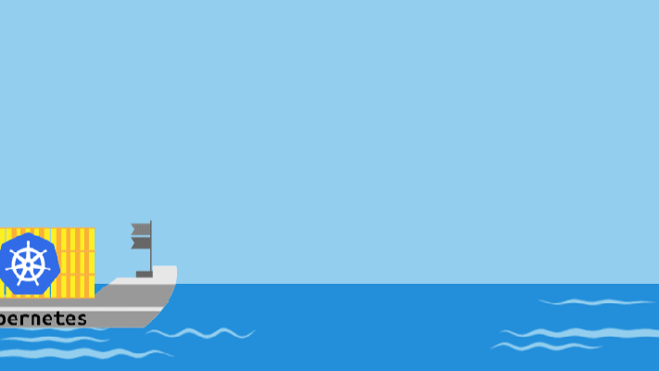
Azure Kubernetes Service(AKS)

Slide 2
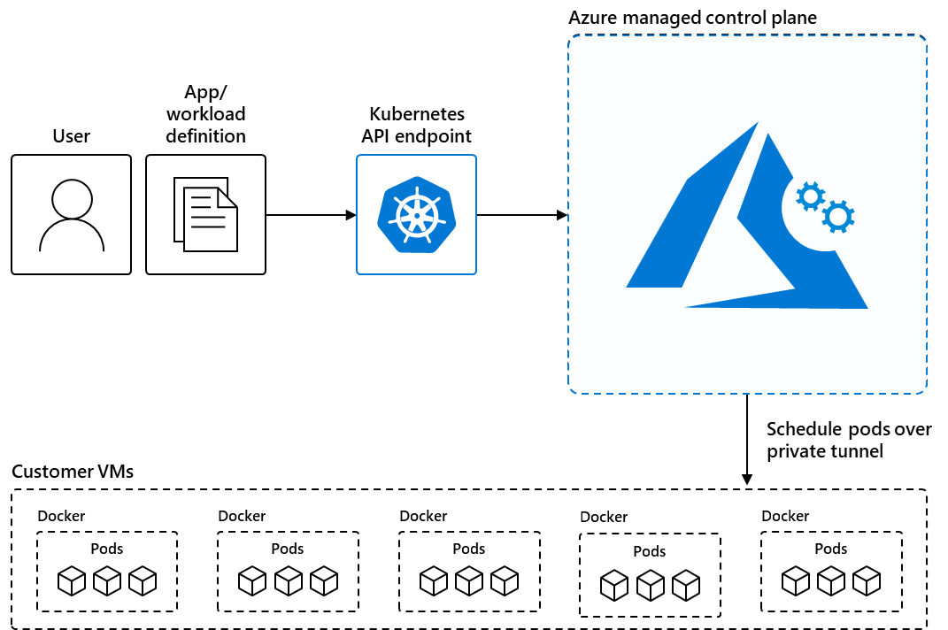

Slide 3
Content
## Introduction
## Kubernetes on Azure overview
## Why AKS & what's your deal?
## Customer stories
## Resources
## Demo’s and QnA

Slide 4
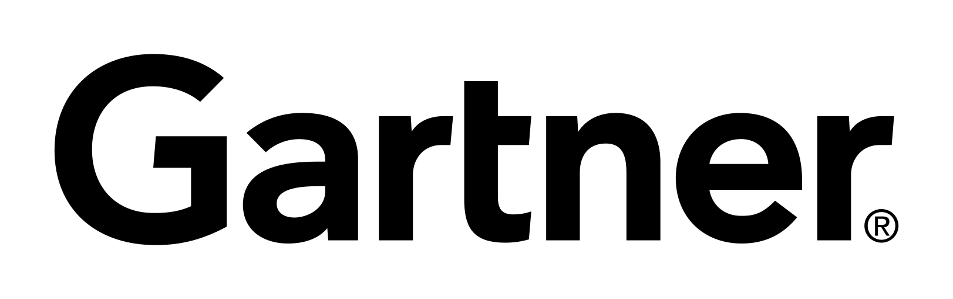
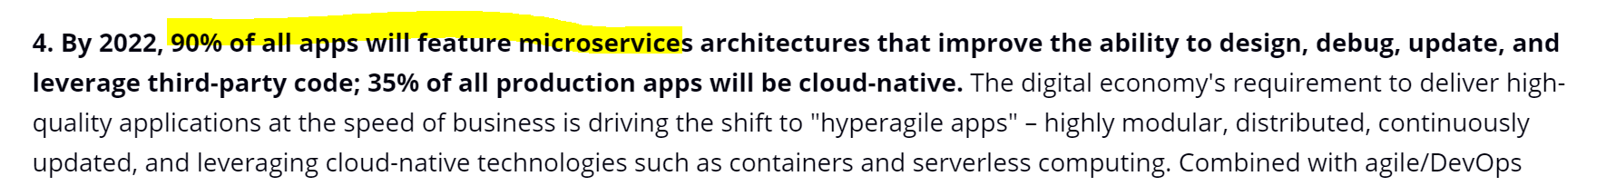
Kubernetes momentum
“By 2020, more than 50% of enterprises will run mission-critical, containerized cloud-native applications in production.”
Larger companies are leading the adoption.
77%
For the organizations running Kubernetes today, 77%¹ of those with more than 1,000 developers are running it in production.
Src: IDC FutureScape (30 Oct- 2018)
¹Heptio: state of Kubernetes 2018

Slide 5
Kubernetes on Azure overview

Slide 6
Kubernetes: the industry-leading orchestrator
Portable
Public, private, hybrid, multi-cloud
Extensible
Modular, pluggable, hookable, composable
Self-healing
Auto-placement, auto-restart, auto-replication, auto-scaling

Slide 7
How Kubernetes works
Kubernetes control
Worker node
kubelet
kube-proxy
Internet
Kubernetes users communicate with API server and apply desired state
Master node
Docker
Pod
Pod
Master nodes actively enforce desired state on worker nodes
API server
Containers
Containers
Worker nodes support communication between containers
-controller-manager
-scheduler
Worker node
kubelet
kube-proxy
Internet
Worker nodes support communication from the Internet
replication, namespace, serviceaccounts, etc.
etcd
Docker
Pod
Pod
Containers
Containers

Slide 8
Managed Kubernetes
Internet
Kubernetes control
Worker node
kubelet
kube-proxy
Master node
Docker
Pod
Pod
API server
Containers
Containers
-controller-manager
-scheduler
Worker node
kubelet
kube-proxy
replication, namespace, serviceaccounts, etc.
etcd
Docker
Pod
Pod
Azure managed control plane
Containers
Containers
master components
node components
Notes:
Kubernetes is made of a central manager (aka master) and some worker nodes.
Master is the Control plane and is responsible to keep the Kubernetes cluster running
The manager runs an API server, a scheduler, various controllers and a storage system to keep the state of the cluster, container settings, and the networking configuration.

Slide 9
How managed Azure Kubernetes Service works
Azure managed control plane
Automated upgrades, patches
High reliability, availability
Easy, secure cluster scaling
Self-healing
API server monitoring
At no charge
App/ workload definition
Self-managed master node(s)
Kubernetes API endpoint
etcd Store
User
API server
Scheduler
Controller Manager
Cloud Controller
Schedule pods over private tunnel
Customer VMs
Docker
Docker
Docker
Docker
Docker
Pods
Pods
Pods
Pods
Pods
Notes:
A Kubernetes cluster is typically made up of
Master nodes for system components like the API server, etcd store, and scheduler
Agent nodes for user container workloads
Managing the cluster involves:
Monitoring the API server
Ensuring HA/DR for the etcd store
Safely managing upgrades across Kubernetes versions
Safely scaling the cluster in and out
Patching master and agent VM nodes
And on and on…
This is complex, error-prone, and expensive
A managed service like AKS moves those tasks to the cloud provider

Slide 10
From infrastructure to innovation
Responsibilities | DIY with Kubernetes | Managed Kubernetes on Azure
Containerization
Application iteration, debugging
CI/CD
Cluster hosting
Cluster upgrade
Patching
Scaling
Monitoring and logging
Managed Kubernetes empowers you to achieve more
Focus on your containers and code, not the plumbing of them
Customer
Microsoft

Slide 11
Azure makes Kubernetes easy
Get started easily
> az aks create -g myResourceGroup -n myCluster --generate-ssh-keys
\ Running ..
> az aks install-cli
Downloading client to /usr/local/bin/kubectl ..
> az aks get-credentials -g myResourceGroup -n myCluster
Merged "myCluster" as current context ..
> kubectl get nodes
NAME STATUS AGE VERSION
aks-mycluster-36851231-0 Ready 4m v1.8.1
aks-mycluster-36851231-1 Ready 4m v1.8.1
aks-mycluster-36851231-2 Ready 4m v1.8.1

Slide 12
Azure makes Kubernetes easy
Manage an AKS cluster
> az aks list –o table
Name Location ResourceGroup KubernetesRelease ProvisioningState
------------------ ---------- -------------- ------------------- -------------------
myCluster westus2 myResourceGroup 1.7.7 Succeeded
az aks upgrade -g myResourceGroup -n myCluster –-kubernetes-version 1.8.1
\ Running ..
az aks scale -g myResourceGroup -n myCluster --agent-count 10
\ Running ..

Slide 13
Cluster Upgrade
Azure makes Kubernetes easy
Upgrade to version 1.11.4
$ az aks upgrade --name myAKSCluster --resource-group myResourceGroup --kubernetes-version 1.11.4
The Kubernetes community releases minor versions roughly every three months
AKS supports *4* minor versions of Kubernetes
The latest stable version upstream and the previous 3
Each supported minor version also supports *2* stable patches.

Slide 14
Azure Devops for K8s

Slide 15



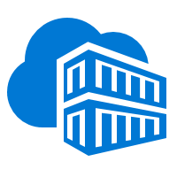


Integrated end-to-end Kubernetes experience
AKS production cluster
Web tier
Inner loop
Azure Container Registry
Source code control
Azure Monitor
Azure DevSpaces
AKS dev cluster
Test
Debug
Business tier
Auto-build
Azure Pipelines/ DevOps Project
Helm chart
Database tier
CI/CD

Slide 16



DevOps on Azure framework
Plan & Track
Develop
Build & Test
Deploy
Operate
Monitor & Learn
Boards
(Azure DevOps)
GitHub
Repos
(Azure DevOps)
Pipelines & Test Plans
(Azure DevOps)
Artifacts & Pipelines
(Azure DevOps)
Policy
Application
Insights
Trello
GitHub
Jenkins
Terraform
Ansible
ELK Stack

Slide 17






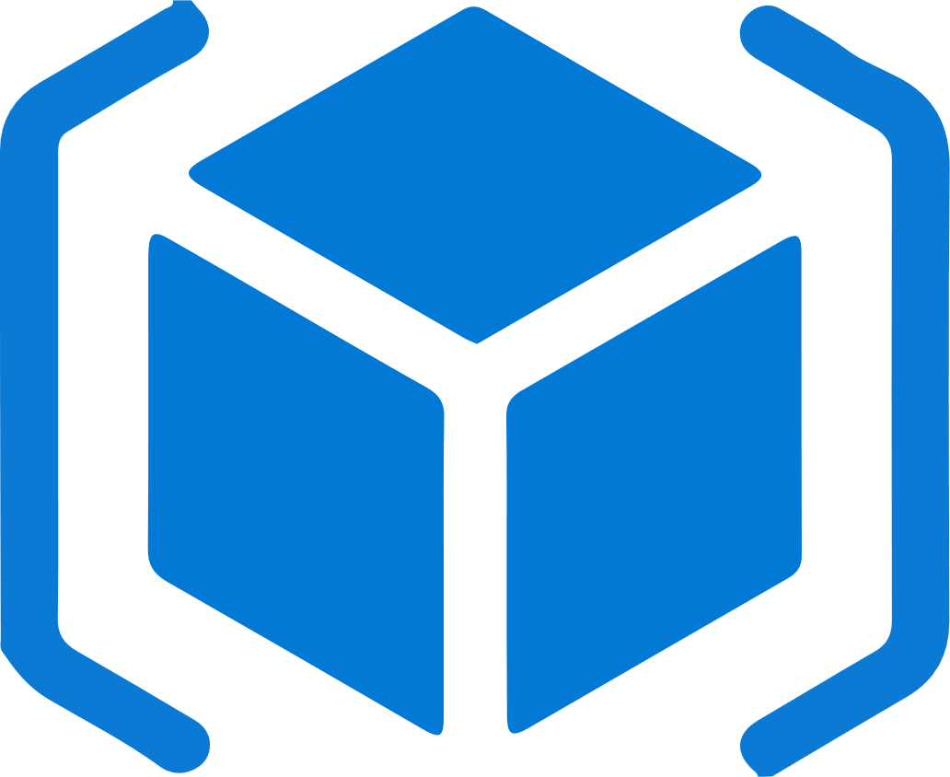
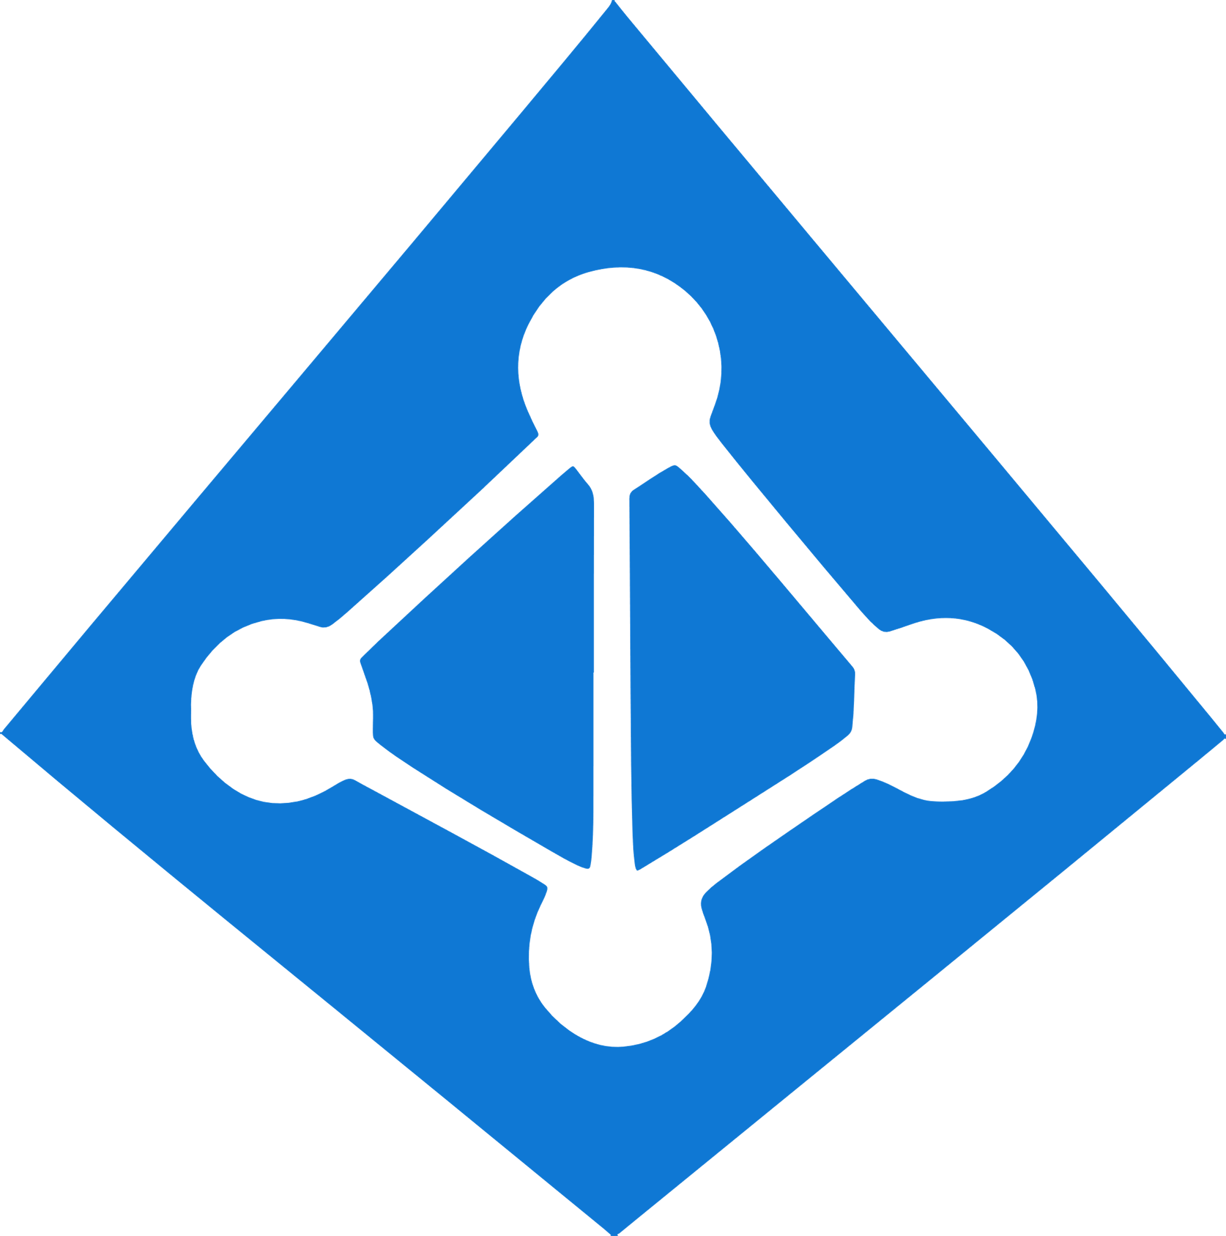


Work how you want with opensource tools and APIs
 | Development | DevOps | Monitoring | Networking | Storage | Security
Take advantage of services and tools in the Kubernetes ecosystem
Leverage 100+ turn-key Azure services
WIP. See comments.
Virtual kubelet
CNAB
DevOps
ARM
Container Registry
Azure Active Directory
Key Vault
VS Code
Azure Monitor
Azure VNET
Azure Storage
Azure Policy

Slide 18




Accelerate containerized development
Kubernetes and DevOps better together
Develop
Deliver
Operate
͏Develop
Native containers and Kubernetes support in IDE
Remote debugging and iteration for multi-containers
Effective code merge
Automatic containerization
Inner loop
Azure Container Registry
AKS production cluster
Source code control
Azure DevSpaces
AKS dev cluster
Scale
Azure Monitor
Test
͏Deliver
CI/CD pipeline with automated tasks in a few clicks
Pre-configured canary deployment strategy
In depth build and delivery process review and integration testing
Private registry with Helm support
Debug
Container image
Azure Pipelines
Helm chart
Terraform
͏Operate
Out-of-box control plane telemetry, log aggregation, and container health
Declarative resource management
Auto scaling

Slide 19
Secure your Kubernetes environment with layers of isolation
Control access through AAD and RBAC
Safeguard keys and secrets with Key Vault
Secure network communications with VNET and policy
Compliant Kubernetes service with certifications for SOC, HIPAA, and PCI

Slide 20
Scale applications on the fly
Built-in auto scaling
Global data center to boost performance and reach
Elastically burst from AKS cluster using ACI
Geo-replicated container registry for low latency image serving

Slide 21
Microsoft innovations on K8s

Slide 22



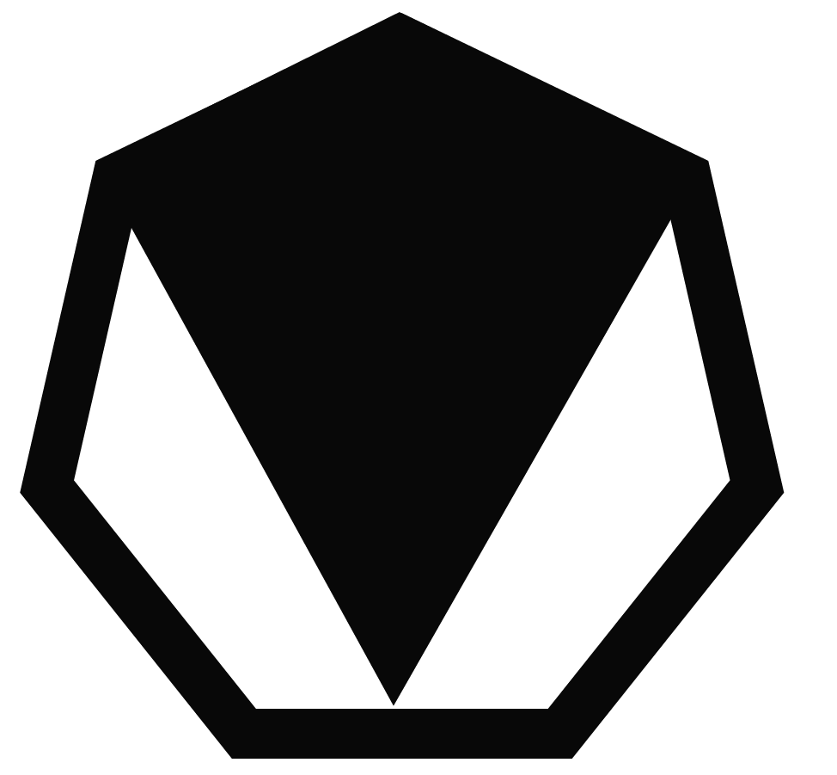


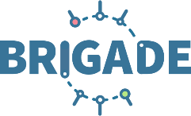
Microsoft drives community-led innovations for Kubernetes
68% of Kubernetes users* prefer Helm as their package manager
Visual Studio Code Kubernetes Extensions has 11K monthly active users
Microsoft is also the maintainer of
Cloud Native Application Bundles (CNAB) spec
Virtual Kubelet
* August, 2018 bi-annual CNCF survey

Slide 23
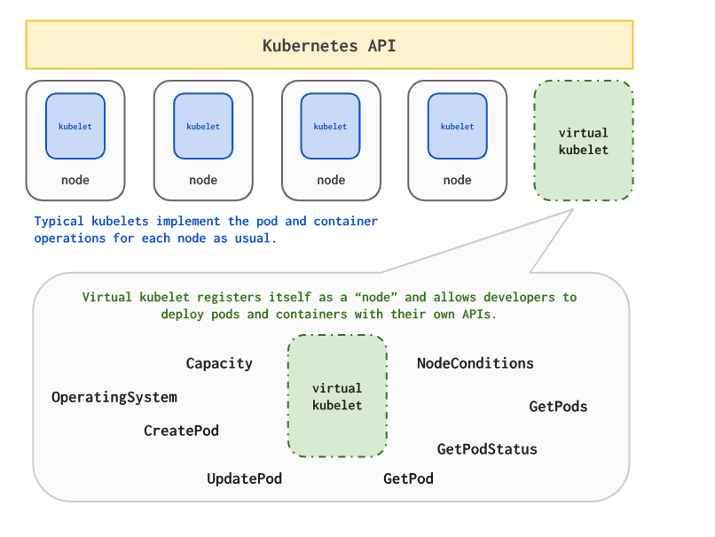

Virtual Kubelet
It allows Kubernetes Nodes to be backed by other services, such as serverless container platforms.
https://github.com/virtual-kubelet/virtual-kubelet

Slide 24
Bursting with the ACI Connector/ Virtual Kubelet
VM
VM
Pods
Pods
Azure Container Instances (ACI)
Application Architect
Pods
Kubernetes control pane
Infrastructure Architect
Deployment/tasks
ACI Connector
VM
VM
Pods
Pods

Slide 25

Run anything, anywhere
Container
Region
Windows
Linux
20+ regions worldwide
Your choice of…
Environment
Public cloud
IoT Edge
Azure Government(coming soon)
Azure Stack

Slide 26
Azure Kubernetes Service (AKS) support for Windows Server Containers
Now you can get the best of managed Kubernetes for all your workloads whether they’re in Windows, Linux, or both
Lift and shift Windows applications to run on AKS
Seamlessly manage Windows and Linux applications through a single unified API
Mix Windows and Linux applications in the same Kubernetes cluster—with consistent monitoring experience and deployment pipelines

Slide 27

Kubernetes is built and maintained by the community
150,000 commits
30,000 contributors
#1 GitHub project
Kubernetes collects wisdom, code, and efforts from hundreds of corporate contributors and thousands of individual contributors
Microsoft is part of this vibrant community and leads in the associated committees to help shape the future of Kubernetes and its ecosystem
CNCF platinum member
CNCF technical oversight committee
CNCF governing board
Kubernetes steering committee
Linux Foundation board member
AKS is certified Kubernetes conformant, ensuring portability and interoperability of your container workloads

Slide 28











Microsoft contributions to the community
Packaging & distribution
Containerd
CNAB
Helm
Duffle
Virtual Kubelet
Open Policy Agent
Scalability & control
KEDA
Service Mesh Interface
Kubernetes developer tooling
Draft
VS Code Kubernetes Extensions
Brigade

Slide 29

Microsoft contributions to the community
Top code contributor to Windows support in Kubernetes
55,000 monthly downloads of Helm
68% of Kubernetes users prefer Helm
1 of 3 top corporate contributors
3x growth of employee contributors within three years
Created the Illustrated Children’s Guide to Kubernetes, now part of CNCF

Slide 30
Top scenarios for Kubernetes on Azure
Lift and shift to containers
Microservices
Machine learning
IoT
Secure DevOps
Cost saving
without refactoring your app
Agility
Faster application development
Performance
Low latency processing
Portability
Build once, run anywhere
Automation
Deliver code faster and securely at scale

Slide 31

Dev Spaces
4
Source control
CI/CD pipeline
5
git commit git push
3
͏The “Integration” dev space is running a full baseline version of the entire application
Container registry
helm upgrade --install
values.test.yaml
helm upgrade --install
values.prod.yaml
AKS cluster
͏John and Sanjay are collaborating on FeatureX; it is setup as a dev space and running all the modified services required to implement a feature
Lisa
Lisa
'up' or F5 debug
values.dev.yaml
namespace
1
Integration
Production
͏Code is committed to the master source control
John
namespace
namespace
John
namespace
2
FeatureX
͏A CI/CD pipeline can be triggered to deploy into “Integration,” which updates the team's baseline
namespace
Sanjay
Sanjay
The same Helm assets used during development are used in later environments by the CD system
namespace
Dev Spaces is enabled per Kubernetes namespaces and can be defined as anything. Any namespace in which Dev Spaces is NOT enabled runs *unaffected*.
Dev Spaces enabled

Slide 32
Kubernetes-based event-driven auto-scaling (KEDA)
Open-source component jointly built by Microsoft and RedHat
Event-driven container creation & scaling Allows containers to “scale to zero” until an event comes in, which will then create the container and process the event, resulting in more efficient utilization and reduced costs
​Native triggers support Containers can consume events directly from the event source, instead of routing events through HTTP
​Can be used in any Kubernetes service This includes in the cloud (e.g., AKS, EKS, GKE, etc.) or on-premises with OpenShift—any Kubernetes workload that requires scaling by events instead of traditional CPU or memory scaling can leverage this component.
Kubernetes cluster
Scaler
AKS cluster
External trigger source
Controller
Metrics adapter
KEDA

Slide 33
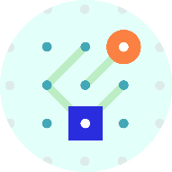

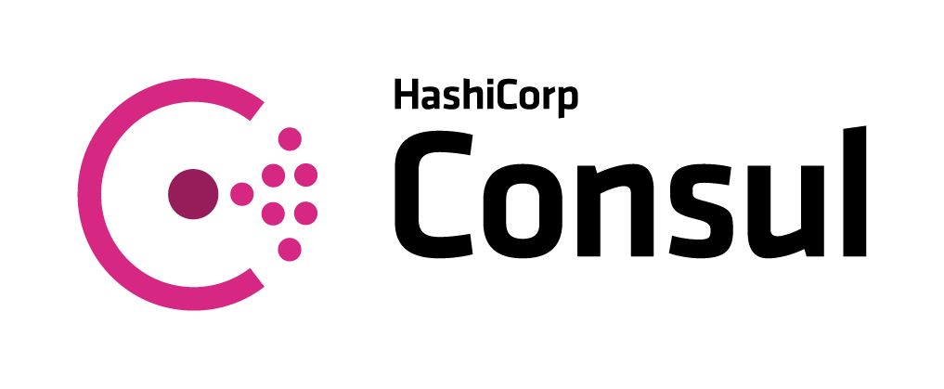

Service Mesh Interface (SMI)
Apps
Tooling
Ecosystem
SMI defines a set of APIs that can be implemented by individual mesh providers. Service meshes and tools can either integrate directly with SMI or an adapter can consume SMI and drive native mesh APIs.
​Standard interface for service mesh on Kubernetes​
​Basic feature set to address most common scenarios​
​Extensible to support new features as they become widely available​
Service Mesh Interface
Routing
Telemetry
Policy
…and more
Kubernetes

Slide 34


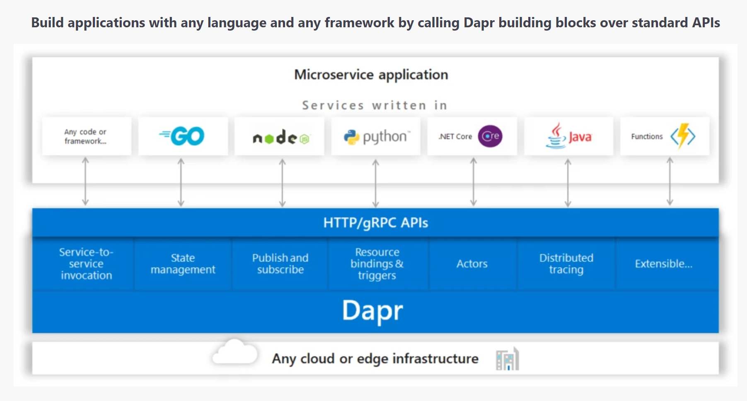
Announcing Dapr
Open source, portable, event-driven runtime helps to build resilient, microservice stateless and stateful applications that run on the cloud and edge
Embraces the diversity of all programming languages & frameworks
Accessed by standard HTTP or gRPC APIs
Agnostic -> you can run your applications locally, on any Kubernetes cluster, and other hosting environments that Dapr integrates with.
https://dapr.io/
An event-driven, portable runtime for building microservices on cloud and edge.

Slide 35
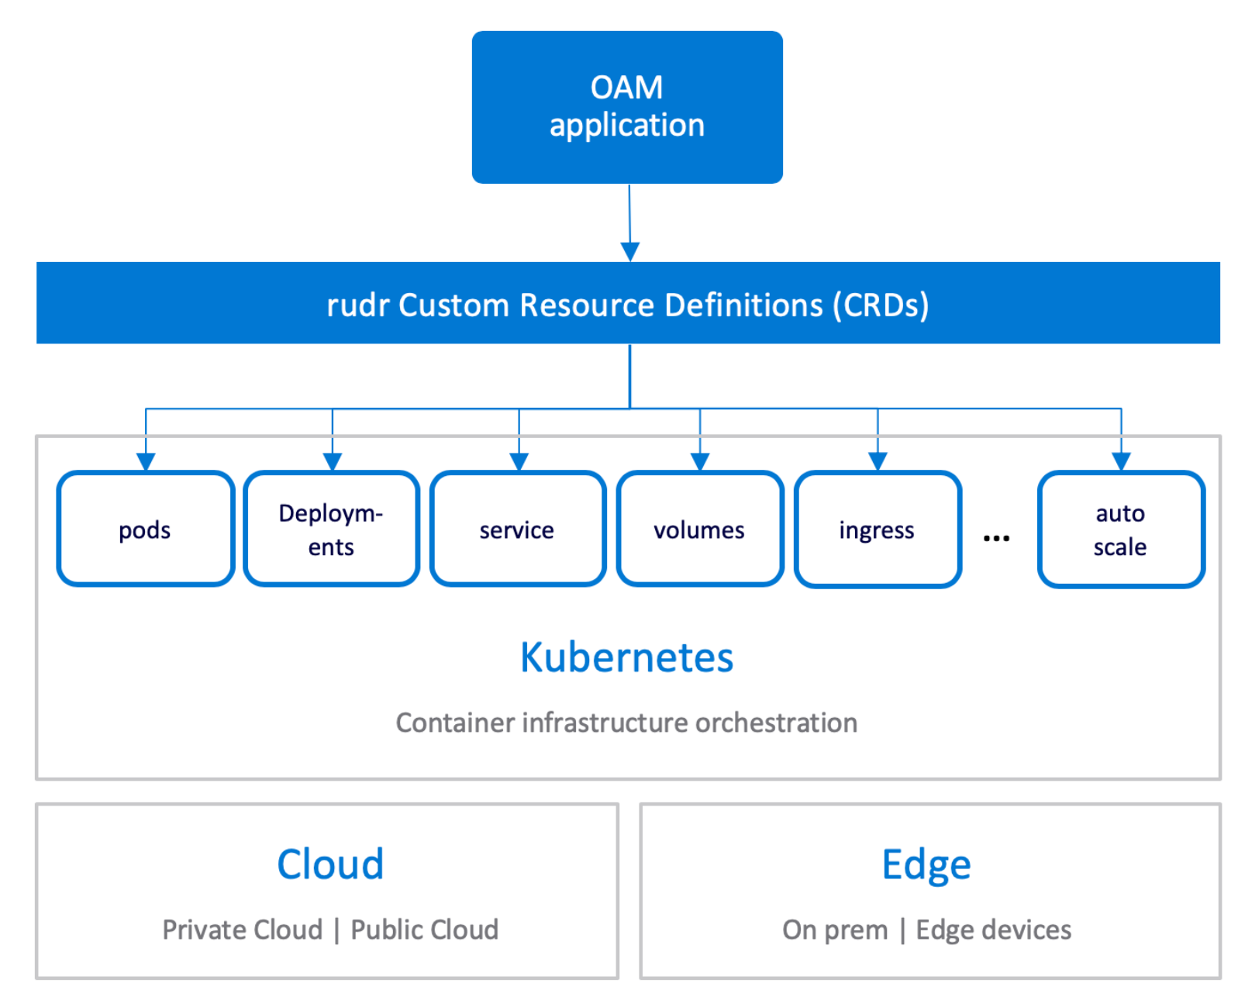
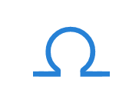
Announcing OAM (Rudr)
- allow users to deploy and manage applications easily on any Kubernetes cluster with separation of concerns of application developer and operator.
THE OAM WAY
A New Application Model
Manage your apps like you manage your teams - with roles and scopes for apps, free of infrastructure.
An opinionated workflow that separates the concerns of App developers, App operators, and Infra Operator
Runs anywhere - a unified approach that works across cloud platforms and edge devices.
https://openappmodel.io/

Slide 36
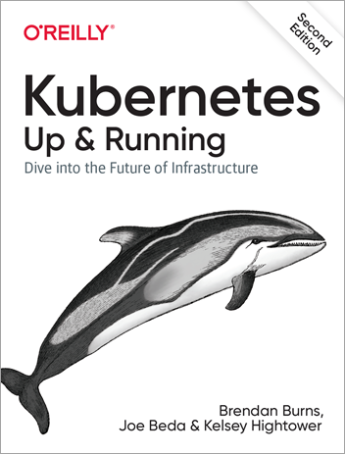
Additional references,
aka.ms/LearnKubernetes
https://github.com/virtual-kubelet/virtual-kubelet
https://docs.microsoft.com/en-us/azure/aks/virtual-nodes-portal
https://openappmodel.io/
https://dapr.io
https://azure.microsoft.com/en-us/resources/kubernetes-up-and-running/
https://aksworkshop.io/

Slide 37
Key Takeaways 1) Azure Dev spaces-> a private share on the K8s cluster for dev and testing. Kind of isolation for each dev without jumping into others work 2) Tooling and flexibility-> integrated with Azure services, tools like VSCode, AAD, ACR, Visual Studio 3) Offer first-of-its serverless k8s (Virtual Kubelet) - Unique project by MS, donated to CNCF. Helps to handle sudden spike in the load by bursting ACI's. We called it as “AKS – Virtual Nodes” 4) Azure DevOps Project- fully functional CI/CD for k8s in few clicks 5) Mixing Windows and Linux nodes on AKS 6) MS leading numerous K8s related projects like Draft, Helm, Brigade, CNAB and Virtual Kubelet 7) Dapr & OAM - new announcements. Microsoft is the #4 contributor to the core Kubernetes project 8) SMI - https://smi-spec.io/ - Service Mesh Interface is a specification that covers the most common service mesh capabilities. KEDA - https://github.com/kedacore/keda (Kubernetes-based Event Driven Autoscaling) 9) Fully managed environment, AKS is a 100% upstream, Enterprise grade support, Most comprehensive set of compliance offerings of any cloud service provider 10) Azure Arc – preview (ignite announcement)

Slide 38
Demo – Azure Virtual Node
Thank you.
Q&A

